Slide 1
Cluster Analysis
SAS version Gap Method

Slide 2
Step 3: Analysis Run
How many clusters do I want?
Diagnostic Statistics
There are two approaches to using technical criteria for deciding how many clusters to keep.
The first approach uses the diagnostic statistics cubic clustering criteria (CCC) and the Pseudo F statistic. Use only if clusters are not highly correlated.
The second method uses what is called “gap analysis”.
Both strategies rely upon comparing characteristics of the clustering solution created against a “reference solution” that relies upon distributing the data points using a uniform random distribution.

Slide 3
Step 3: Analysis Run
How many clusters do I want?
Gap Analysis
Gap Analysis is another method for determining the number of clusters to keep (Tibshairani, Walther and Hastie, 2000).
Gap analysis is fundamentally based upon the within cluster dispersion of data points. Use PROC HPCLUS. This proc will also allow you to use nominal level variables in the cluster analysis).

Slide 4

Step 3: Analysis Run
How many clusters do I want?
Gap Analysis
D_{r} represents the dispersion of data points within a single cluster
Difference between two data points

Slide 5

Step 3: Analysis Run
How many clusters do I want?
Gap Analysis
Then the pooled within cluster sum of squares around the cluster means is represented by W_{k}
Sum of all pairwise distances between data points in a cluster
Sample size cluster r

Slide 6

Step 3: Analysis Run
How many clusters do I want?
Gap Analysis
Then we can look to see how different the within cluster sum of squares calculated from the data is (Wk) from that within cluster sum of squares calculated from the reference distribution E*n.
k is number of clusters
Pooled sum of squares from reference data set
Pooled within sum of squares from data

Slide 7
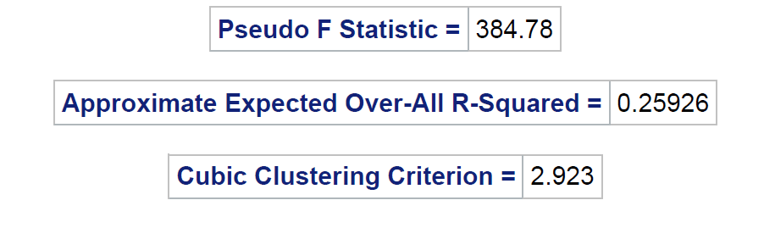
Step 4: Identification of Key Sections
K Means Diagnostics Method
Notes:
If students will be required to write a research proposal or conduct a study as a course project, or if students have ongoing research projects such as theses or dissertations, and if the class is reasonably small, it may be useful to elicit descriptions of their research interests early in the course and use these research questions as a focus for discussion. If the class is large or students do not have well defined research interests, you may want to focus discussion on the empirical examples presented in the chapter.

Slide 8
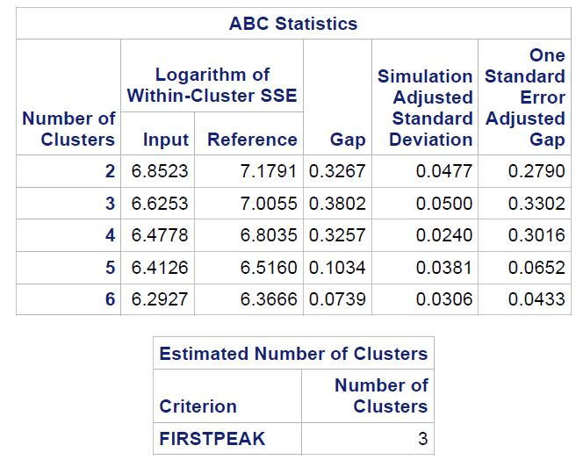
Step 4: Identification of Key Sections
K Means Gap Analysis Method
Notes:
If students will be required to write a research proposal or conduct a study as a course project, or if students have ongoing research projects such as theses or dissertations, and if the class is reasonably small, it may be useful to elicit descriptions of their research interests early in the course and use these research questions as a focus for discussion. If the class is large or students do not have well defined research interests, you may want to focus discussion on the empirical examples presented in the chapter.

Slide 9
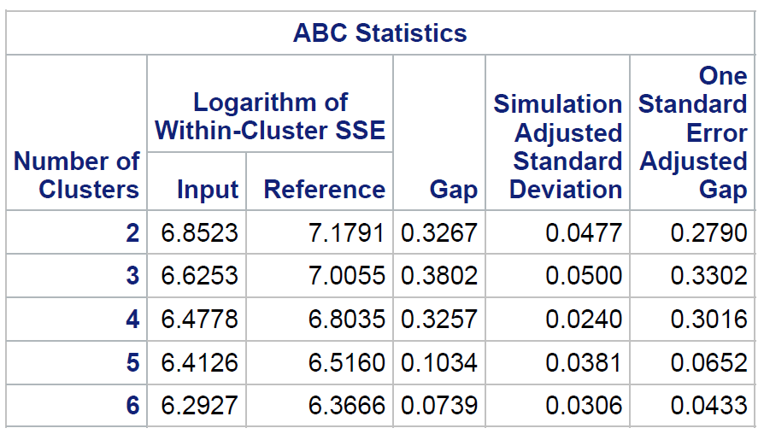
Step 5: Interpretation of the Key Statistics
How many clusters do I want?
Gap Analysis
Here is the “meat” of the gap analysis

Slide 10

Step 5: Interpretation of the Key Statistics
How many clusters do I want?
Gap Analysis
Here is the “meat” of the gap analysis. Using the formula
Gap(2) = 7.1791 - 6.8523 = .3267

Slide 11
Step 5: Interpretation of the Key Statistics
How many clusters do I want?
Gap Analysis
Here is how you determine the number of clusters. Find the first peak or maximum. Here you see it is at cluster 3.

Slide 12
Step 5: Interpretation of the Key Statistics
How many clusters do I want?
Gap Analysis
Now subtract the simulation adjusted standard deviation from the gap number for cluster=3
.3802 - .0500 = .3302

Slide 13
Step 5: Interpretation of the Key Statistics
How many clusters do I want?
Gap Analysis
Is the gap number for cluster = 3 farther away than 1 standard deviation from the previous gap number (e.g. cluster number gap #)
.3802 - .0500 = .3302 and now check if .3302 > .3267 YES!

Slide 14
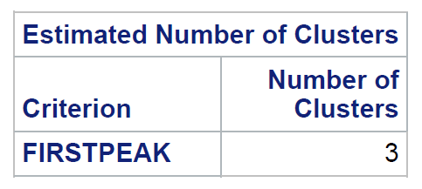
Step 5: Interpretation of the Key Statistics
How many clusters do I want?
Gap Analysis
Is the gap number for cluster = 3 farther away than 1 standard deviation from the previous gap number (e.g. cluster number gap #)
.3802 - .0500 = .3302 and now check if .3302 > .3267 YES!
dd
And SAS confirms this!

Slide 15
Step 5: Interpretation of the Key Statistics
How many clusters do I want?
So now I’m confused. The diagnostic statistics say 4 clusters and the gap analysis says 3 clusters. Time to go to Hills and Dales?
Nope – if you read the “fine print” on PROC HPCLUS you will see that the clustering method is “aligned box criterion”, which is a Monte Carlo technique to calculate the residual sum of squares between the reference distribution and the actual data run.
The CCC in the FASTCLUS method used a heuristic approximation algorithm to calculate the residual sum of squares between the reference distribution and the actual data run.

Slide 16
Step 5: Interpretation of the Key Statistics
How many clusters do I want?
So now I’m still confused. Which one should I use?
Statisticians argue about which criteria to use. Tibshairani, Walther and Hastie (2000) label the traditional such as CCC and Pseudo F methods as “folklore”. The CCC was developed before large scale computing was available to do Monte Carlo estimates. So probably gap analysis, given their arguments in their paper, is probably a better choice.

Slide 17
Step 5: Interpretation of the Key Statistics
How many clusters do I want?
A bit of a CAUTION here – note that our 1,000 cases has been reduced to 223 because of missing values. In the real world that is bad – you don’t want to whack all of those cases. I am using this example here because it’s fast – in real life you would want to deal with this missing cases hopefully by imputation or some similar scheme.
.

Slide 18
Step 6: Reinforcement of Most Crucial Key Statistics
So while we need to look at all of the run, the most key components are to look at the diagnostic statistics – either the CCC ad Pseudo F or do a gap analysis.
There will be other less technical criteria that we will talk about in the second half of our discussion in the next deck.
.

Slide 19
Step 7: Sample Size and Power
Things that will make for a better cluster analysis
Variables that are characterized by higher levels of measurement
Variables that contain fewer outliers
Driver variables that are not highly correlated
Sample size – SAS recommends minimum size of 100. Others recommend minimum size of 500. Foreman (1984) suggests 2^{m}, where m is number of variables. This obviously does not work well for solutions with a small number of drivers.

Slide 20
Step 8: Assumptions of the Test
Formal statistical assumptions are often far and few between for cluster analysis. However, we can suggest that the following will result in better separated, more distinct solutions.
Clusters are spherical in shape
Similar size n’s across clusters (k means tends to do that anyway)
Similar variance-covariance structure across clusters
Data points are independent – e.g. no repeated measures

Slide 21
Step 9: Notes
Proc HPCLUS can be used to cluster nominal level variables. Instead of the mean, the mode is used for determining centroids.
Proc MODCLUS has some inferential tests where you can get p values if you really are addicted to them
The statistical criteria for cluster analysis is only part of the game. Part 2 where we look at other criteria for judging the actual quality of a cluster solution is even more important. The number of clusters game only gets you to a possible solution, you then have to evaluate it.

Slide 22
Code
libname mylib '\\client\C$\Users\ska669\Documents\DA6823 summer 2017\sas data files';
/* go get the combo file */
data letscluster;
set mylib.mycombo;
proc hpclus data=letscluster maxclusters=6
noc=abc(b=20 minclusters=2 align=pca criterion=firstpeak);
Score out=mycluster;
input earlyadopt socialphone loser ad_receptivity / level=interval;
run;

Slide 23
Code: a closer look
proc hpclus data=letscluster maxclusters=6 maxiter=100
noc=abc (b=20 minclusters=2 align=pca criterion=firstpeak);
Score out=mycluster;
input earlyadopt socialphone loser ad_receptivity / level=interval;
Run;
Aligned box criteria
Data set
Max number clusters
Max iterations
# ref data sets
Min number clusters
PCA align box
Suggest first peak as # clusters
Assign cluster number to cases
Output data set with all variables plus CLUSTER variable
Statistical drivers
Level of measurement

